Slide 1
Even Though Python is Slow
Ching-Chuan Chen

Slide 2
Python is Slow…
How slow is Python?
Why Python is so popular?
How could we get better performance?
Secret Topic 😀

Slide 3
How slow is Python?
Slow?
Why Python is so popular?

Slide 4
The trend of Python in the TIOBE Index
Year | Ranking
2020 June | 3
2019 June | 3
2018 June | 4
2017 June | 4
2016 June | 4
2016 May | 5
2015 June | 6
2014 June | 8

Slide 5
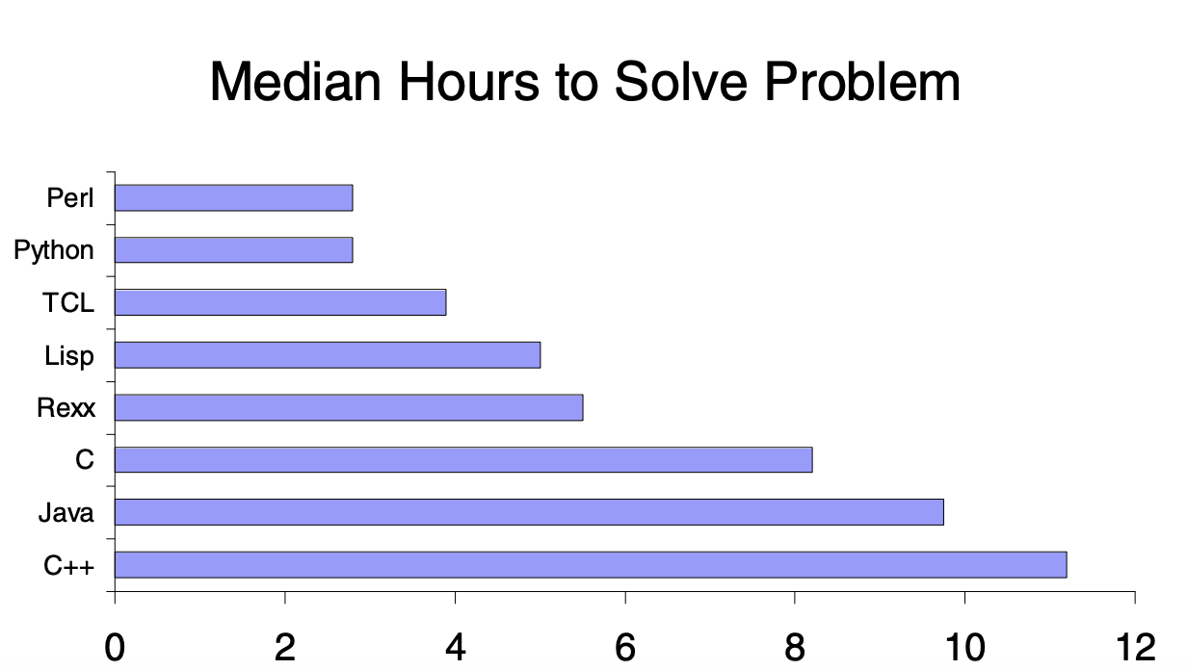
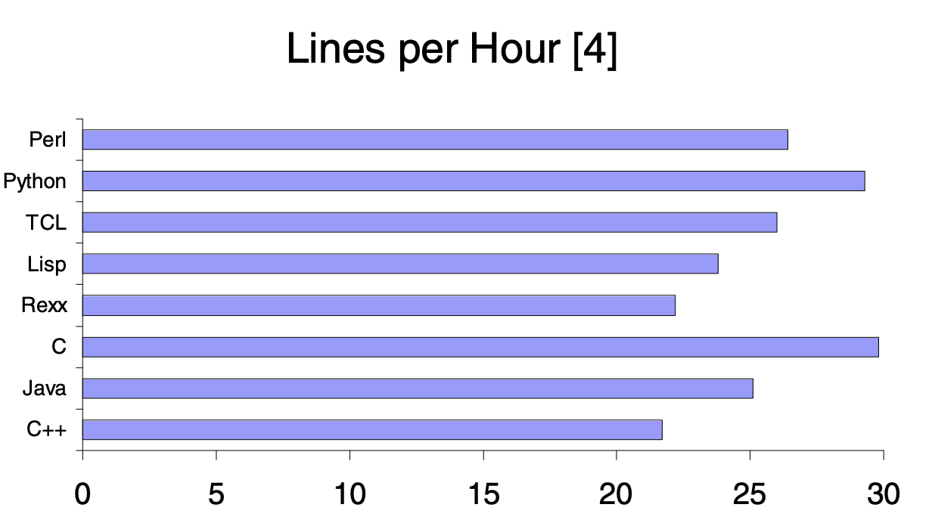
Why Python is so popular?
Productivity
Python

Slide 6
How could we get better performance in Python?

Slide 7
Better Performance in Python
Rewrite Python Interpreter
PyPy (Psyco 2) supported by Python Foundation
EU is the first sponsor
Pyjion supported by Microsoft
Pyston supported by Dropbox
Jython supported by Python Foundation
IronPython supported by Microsoft
RustPython: https://rustpython.github.io/demo/

Slide 8
Better Performance in Python
Introduce LLVM JIT compiler
Numba (based on llvmlite)
FFI
Rust
Golang
Java / Kotlin / Scala
Julia
C/C++ support

Slide 9
Introduction to Cython

Slide 10

Pronunciation of Cython
Wanna learn Cython, pronounce correctly first

Slide 11
Describe Cython in One Sentence
Cython = Python with the static type
Cython = Python which is able to be complied
Cython = Write C with Python syntax

Slide 12
Cython Files
.pyx = Cython file extention
.pxd = The header file in Cython like .h in C
See example
mdlpdisc/mdlpdisc at master · ChingChuan-Chen/mdlpdisc (github.com)

Slide 13
Cython Syntax – Variable Declaration
Without type
n = 0
With type
cdef int n = 0 / cdef int n
With numpy type
cimport numpy as np
cdef np.int n = 0
cdef np.ndarray x = np.zeros([5, 4], dtype=np.int)
cdef np.ndarray[np.int_t, ndim=2] x = np.zeros([5, 4], dtype=np.int)

Slide 14
Cython Syntax – Function Declaration
def
Regular Python function which is only able to be called by Python
cdef
Regular Cython function which is only able to be called by Cython
cpdef
It’s able to be called by Python and Cython

Slide 15
Type Conversion Between Python and Cython
C Types / C++ Types | From Python Types | To Python Types
[unsigned] char, [unsigned] short int, long | int, long | int
[unsigned] Int, long, long long | int, long | long
float, double, long double | int, long, float | float
struct |  | dict
std::vector | iterable | list
std::string | iterable | bytes
std::set | iterable | set
PS: You can also define C++ class in Cython to use in Python https://cython.readthedocs.io/en/latest/src/userguide/wrapping_CPlusPlus.html

Slide 16
Using Cython in Jupyter Notebook
In Jupyter Notebook, we can use the following two magic commands to write Cython
%load_ext Cython
%%cython

Slide 17
Example - Fibonacci
%%cython
def fib_def(n):
if n < 2:
return n
a, b, i = 0, 1, 2
while i <= n:
a, b = b, a + b
i += 1
return b

Slide 18
Example - Fibonacci
%%cython
cpdef fib_cpdef(long n):
if n < 2:
return n
cdef long a = 0, b = 1, i = 2
while i <= n:
a, b = b, a + b
i += 1
return b

Slide 19
Example - Fibonacci
%%cython
cpdef fib_cpdef(long n):
if n < 2:
return n
cdef long a = 0, b = 1, i = 2
while i <= n:
a, b = b, a + b
i += 1
return b

Slide 20
Example - Fibonacci
%%cython
cdef fib_inner(long n):
cdef long a = 0, b = 1, i = 2, swap = 0
while i <= n:
a, b = b, a + b
i += 1
return b
def fib_cdef(int n):
if n < 2:
return n
return fib_inner(n)

Slide 21
Example - Fibonacci
Test Program:
%%timeit –r 100 –n 10
[fib_func(x) for x in range(93)]
Implementation | Mean | Std. Dev.
Python | 200 µs | 13.9 µs
Cython - def | 94.4 µs | 8.43 µs
Cython - cpdef | 6.74 µs | 1.42 µs
Cython - cdef | 6.72 µs | 460 ns

Slide 22
Using Cython in Python Module
You can’t directly use numpy and Cython in setup.py. If there is no numpy and Cython when installation, it fails.
We need a hack! Example setup.py: mdlpdisc/setup.py at master · ChingChuan-Chen/mdlpdisc (github.com)

Slide 23
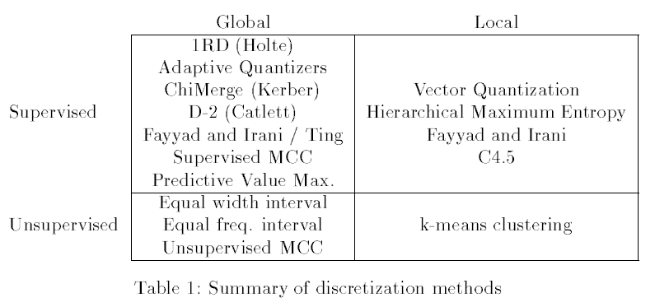
Case Study: mdlpdisc
Git Repository
https://github.com/ChingChuan-Chen/mdlpdisc
Recall
To discretize the continuous-valued attributes into categorical ones

Slide 24
Case Study: mdlpdisc
Main changes are to engage with C++ files and OpenMP
Faster sorting two vectors
Calculate entropy parallelly
Implementation | Mean | Std. Dev.
Cython – Original One | 944 ms | 8.8 ms
Python | 16 s | 50.8 ms
Cython – OpenMP | 795 ms | 2.46 ms

